Slide 1


University of Basrah
College of Nursing
L5
Family

Slide 2
Objectives
At the end of the lecture the student will be able to:
1- To understand the detentions, types , stages of family
2- to understand the basic needs of the family
3- to have an idea about the modern family characteristics and problems.

Slide 3
A family is a group of two or more persons related by birth, marriage, or adoption who live together; all such related persons are considered as members of one family.
Why is family so important?
The family unit is recognized as the most important social institution whose primary and crucial role is related to child care and development.
Love, equally necessary for social and emotional development of a child, is received in the family through positive family interactions.

Slide 4
What is the basic concept of family in sociology?
Family is a socially recognized group (usually joined by blood, marriage, cohabitation, or adoption) that forms an emotional connection among its members and that serves as an economic unit of society.
Sociologists identify different types of families based on how one enters into them.
A family of orientation refers to the family into which a person is born. A family of procreation describes one that is formed through marriage. These distinctions have cultural significance related to issues of lineageالنسب

Slide 5
The family life cycle
Family life cycle a set of predictable steps and patterns families experience over time.

Slide 6
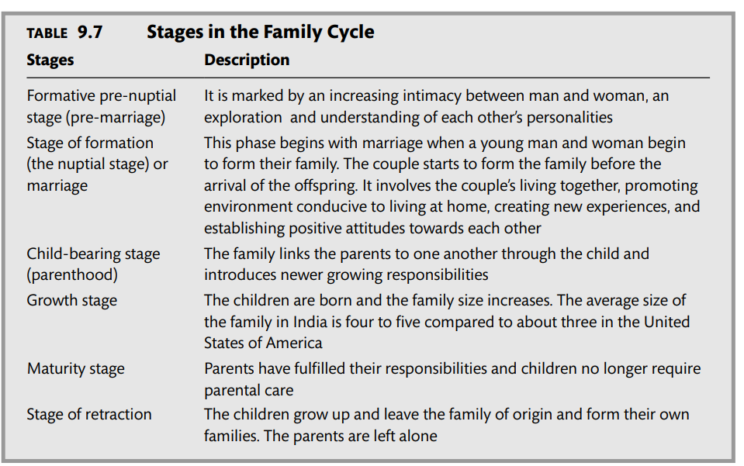

Slide 7
The family life cycle was used to explain the different processes that occur in families over time. Sociologists view each stage as having its own structure with different challenges, achievements, and accomplishments that transition the family from one stage to the next.
For example, the problems and challenges that a family experiences in a married couple with no children are likely much different than those experienced in a married couple with teenagers.
The success of a family can be measured by how well they adapt to these challenges and transition into each stage.

Slide 8
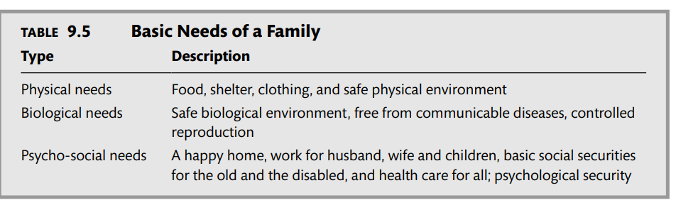

Slide 9
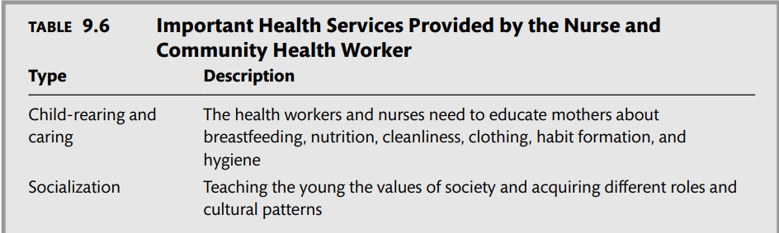
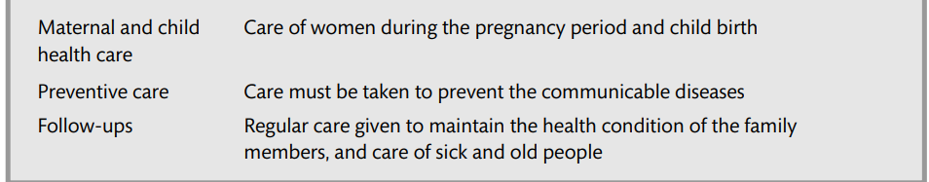

Slide 10
Types of families
Nuclear family: Nuclear or elementary family is universal in all human societies. It consists of the married couple and their children. They occupy the same house called home. The husband plays a dominant role in the family
Joint family : Joint family or extended family is a kind of family grouping which is common. It consists of a number of married family couples and their children who live together in the same household. All the men are related by blood. The property is held in common. The senior male member controls the internal and external affairs of the family.
The three-generation family: This is a household where there are representatives of three generations—the grandfather, the father, and the grandchildren. The sons continue to live with their parents and have their own children

Slide 11
Other types of families
Single Parents: children lived with a single parent only
Blended Families: A family formed by the remarriage of a divorced or widowed parent. It includes the new husband and wife, plus some or all of their children from previous marriages.
Foster Families

Slide 12
Modern Family
Features of the Modern Family
The modern family is a smaller family. It is not a joint family. There is a tendency to have a smaller family and contraceptives are in large use. Women are employed in factories and offices. They are economically independent. The family changed from production to consumption unit. Various home appliances for cooking, baking, and washing, and the use of readymade food products provide lot of leisure to women. Parental control and authority have lessened.
Notes:
]

Slide 13
As the structure of family changes over time, so do the challenges families face. Events like divorce and remarriage present new difficulties for families and individuals. Other long-standing domestic issues such as abuse continue to strain the health and stability of today’s families.

Slide 14
What is a family problem?
Family issues are when conflict between or related to family members becomes especially intense or frequent, to the point that it interrupts your day-to-day life.
Some degree of conflict within families is normal (and even, to a point, healthy) and the family dynamic for each person may be different.

Slide 15
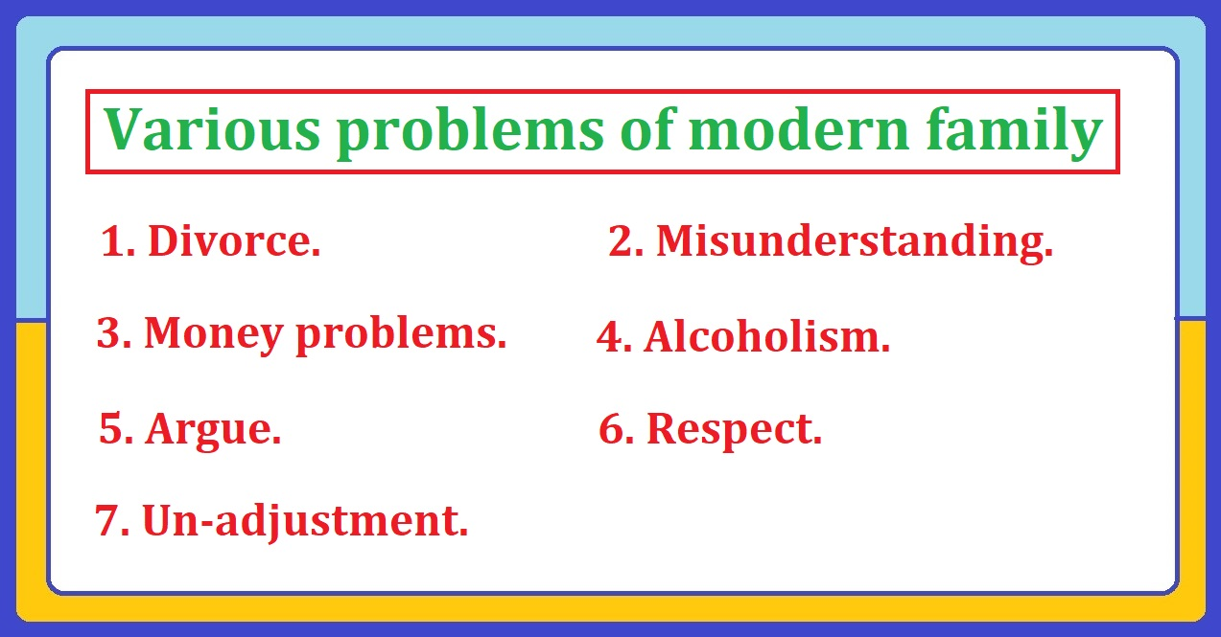

Slide 16
1. Divorce.
The large number of divorce see in the modern family. They did love marriage. They are divorce each other because of misunderstanding.
2. Misunderstanding.
In the modern family has a lot of misunderstanding such as beliefs, telling lies etc. Most of the love marriages are break due to the misunderstanding. Sometime small mater can create a big problems due to the misunderstanding.

Slide 17
3. Money problems.
The economy is basic needs of the people as well as family. Money is the stability of a family. Money is the common problem of the family. Some modern family has a lot of money problem because they are not work. They are spend a big amount of money drinking alcohol, smoking etc. So, money is a big problem of modern family.
4. Alcoholism.
Most of the people are taking alcohol. The alcohol is causes cancer and even death. When a person takes alcohol in that time he/ she doesn’t know the stability. Taking alcohol is create lots of problems like money, physical, mental as well as environmental. Most of modern family members are taking alcohol. So, alcoholism is an another problem of modern family.

Slide 18
5. Argue.
Argue is the a common problem of family. Modern Families are perform love marriage. And the modern family couples both husband and wife are equal. They are argue sometime because they are same age, education. Sometime they are argue for preparing food because they both are having jobs. So, it is a big problem.
6. Respect.
Respect is refers to the giving value. Every wife should give respect or value of her husband. When a wife doesn’t give respect to her husband, it is not possible to take respect from her husband. For example give respect and take respect. In modern family there is less respect because they are both earnings money. So, it’s major problem of modern family.

Slide 19
7. Un-adjustment.
Un-adjustment is the another problem of joint family. When a wife is not adjust her husband family. She is feel alone and behave like other person. She needs separation from this family due to the un-adjustment.

Slide 20
Quiz
1- What are the main types of families ?
2- Enumerate the basic needs of the family.
3- What are the health services provided to the family by the nurse?
4- Write about the characteristics of the modern family.
5- Enumerate the problems facing modern family.

